Slide 1
Network Troubleshooting Toolkit
Student Name: Patel Devendra

Slide 2
1. Project Profile
Project Title: | Networking Troubleshooting Toolkit
Objective: | To design and implement a practical Network Troubleshooting Toolkit that streamlines error detection, root cause analysis, and resolution workflows—empowering secure and efficient network management for academic and investigative environments.
Platform:- | Parrot OS
Tools:- | Ifconfig, ping, traceroute, ssh, ss, scp, speedtest-cli, systemctl, nslookup, mali, crontab, postfix.
Developed By:- | Patel Devendrakumar

Slide 3
2. Introduction
This document provides a detailed walkthrough of a user creating and executing a comprehensive network diagnostics script on a Parrot Security OS (a Debian-based Linux distribution). The process involves scripting, command-line troubleshooting, and automation to identify and report on network health. The analysis covers the script's purpose, its components, the execution output, and the challenges encountered, highlighting practical system administration and networking skills.

Slide 4
2.1 Over-View
This practical equips learners with hands-on troubleshooting skills using real-world tools. Each command executed contributes to a deeper understanding of network behavior and system diagnostics. The structured, stepwise approach reflects disciplined learning and prepares students for technical roles in cybersecurity and digital forensics.

Slide 5
3. Tools & Description
Category | Tools Used
System & File Management | mkdir, cd , ls touch, chmod, nano, cat
Network Diagnostics | Ip, ifconfig, traceroute, ss, ssh, nslookup
Automation | Custom Bash Script(network_diagnostics.sh)
Service & Email | Systemctl, apt, mail

Slide 6
4. Background & Motivation
Background:-
Network troubleshooting is a critical but often manual and inefficient IT task. Technicians typically run a series of disconnected command-line tools (e.g., ping, traceroute). to diagnose issues, a process that is time-consuming, prone to inconsistency, and lacks standardization.
This project was initiated to automate and standardize this initial diagnostic phase. It addresses the core challenges of manual troubleshooting by developing a single, comprehensive script that automatically executes a full suite of network checks, consolidates the results into a structured report, and provides a clear, actionable snapshot of system network health. The goal is to shift from a reactive, error-prone process to a proactive, efficient, and reliable one, significantly reducing diagnostic time and improving operational consistency.

Slide 7
Motivation:-
This project was motivated by the critical need to eliminate inefficiency and inconsistency in network troubleshooting. Manual diagnosis is slow, repetitive, and varies between technicians, leading to prolonged downtime and potential for error.
We were driven to create a force multiplier that automates the tedious data-gathering process. This tool empowers IT teams to shift from being reactive problem-solvers to proactive system guardians, ensuring faster resolution times, standardized procedures, and robust documentation for every network incident.

Slide 8
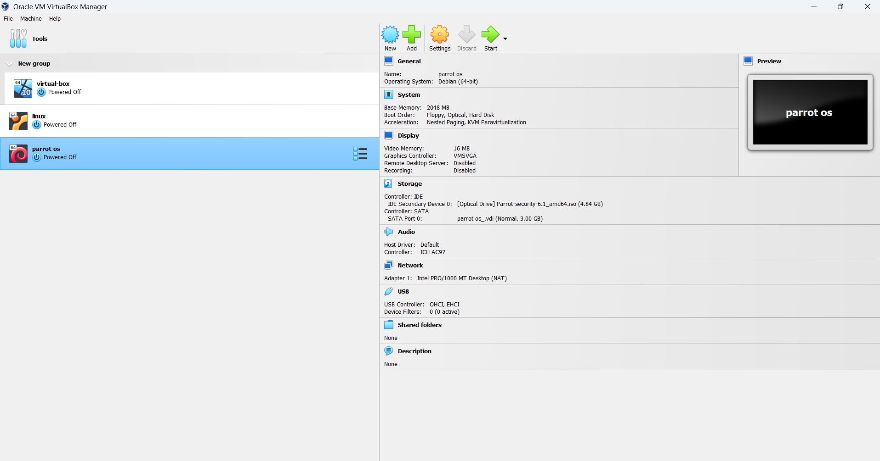
5. POC
Open VirtualBox Machine

Slide 9
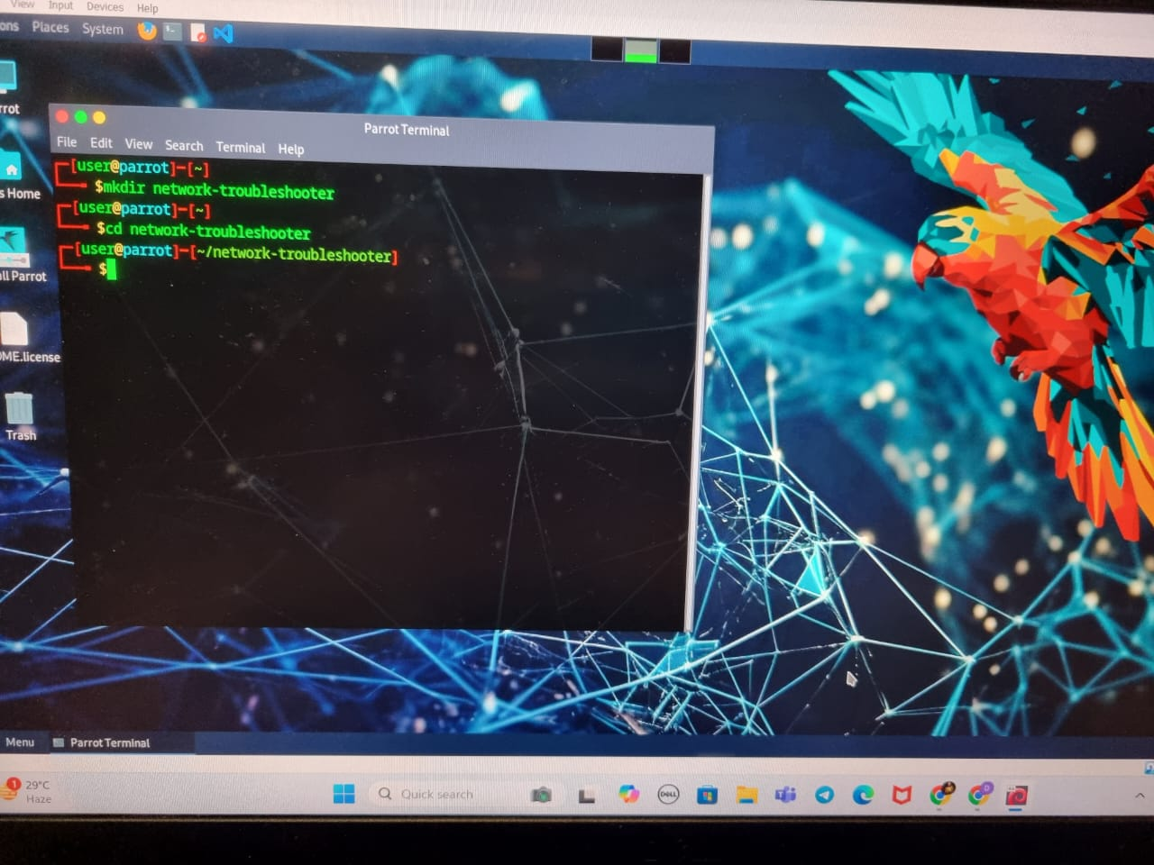
2. And then Open Parrot OS

Slide 10
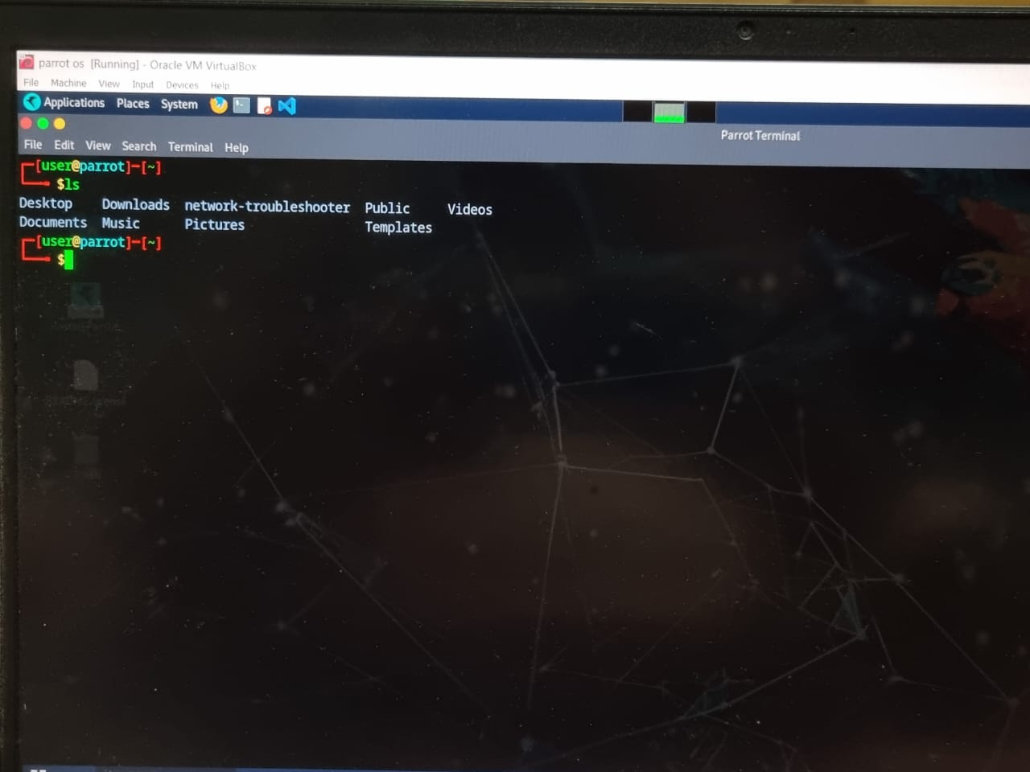
Apply LS command

Slide 11
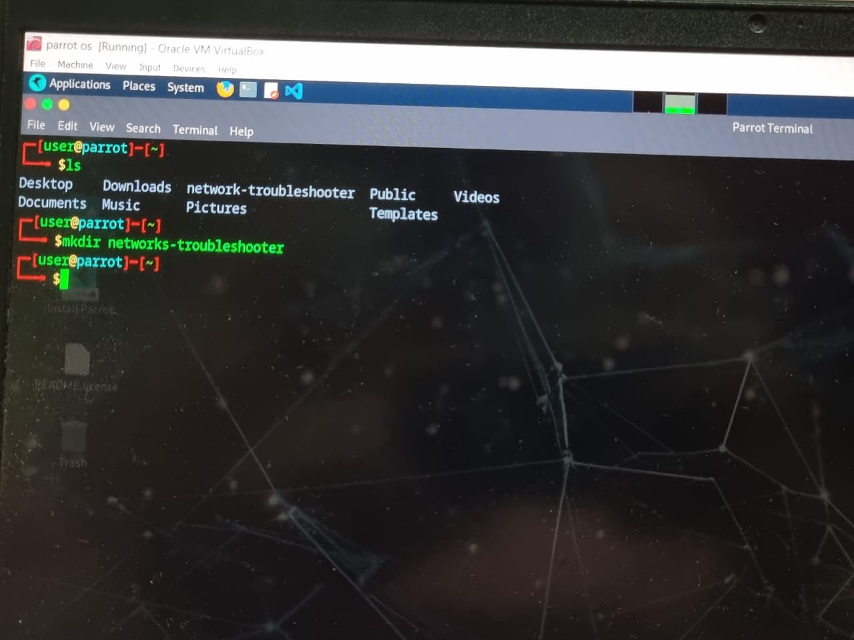
4. Create a directory such as name as network-troubleshooter

Slide 12
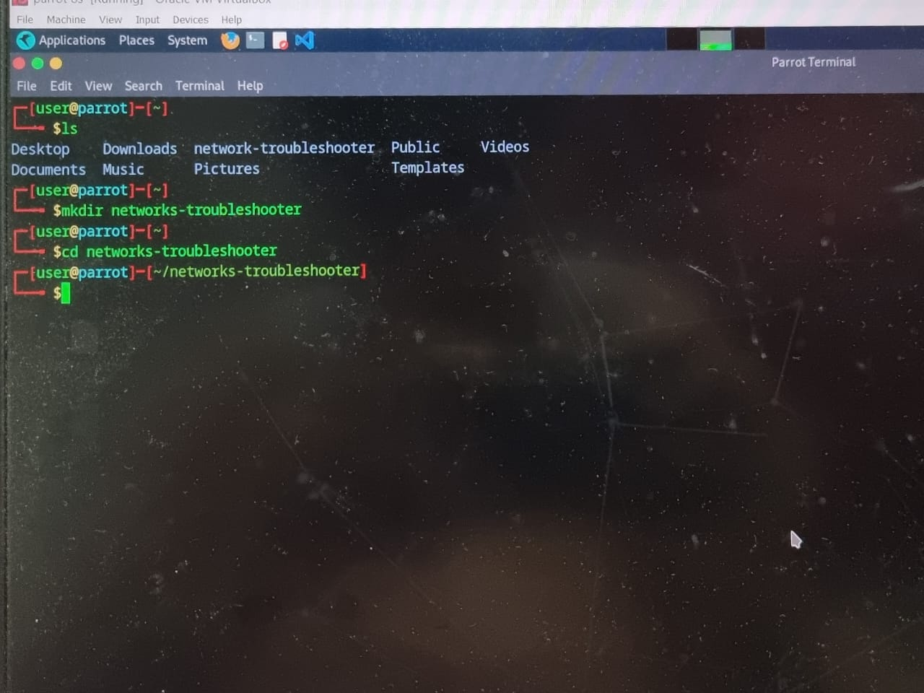
5. Write a change directory for network-troubleshooter

Slide 13
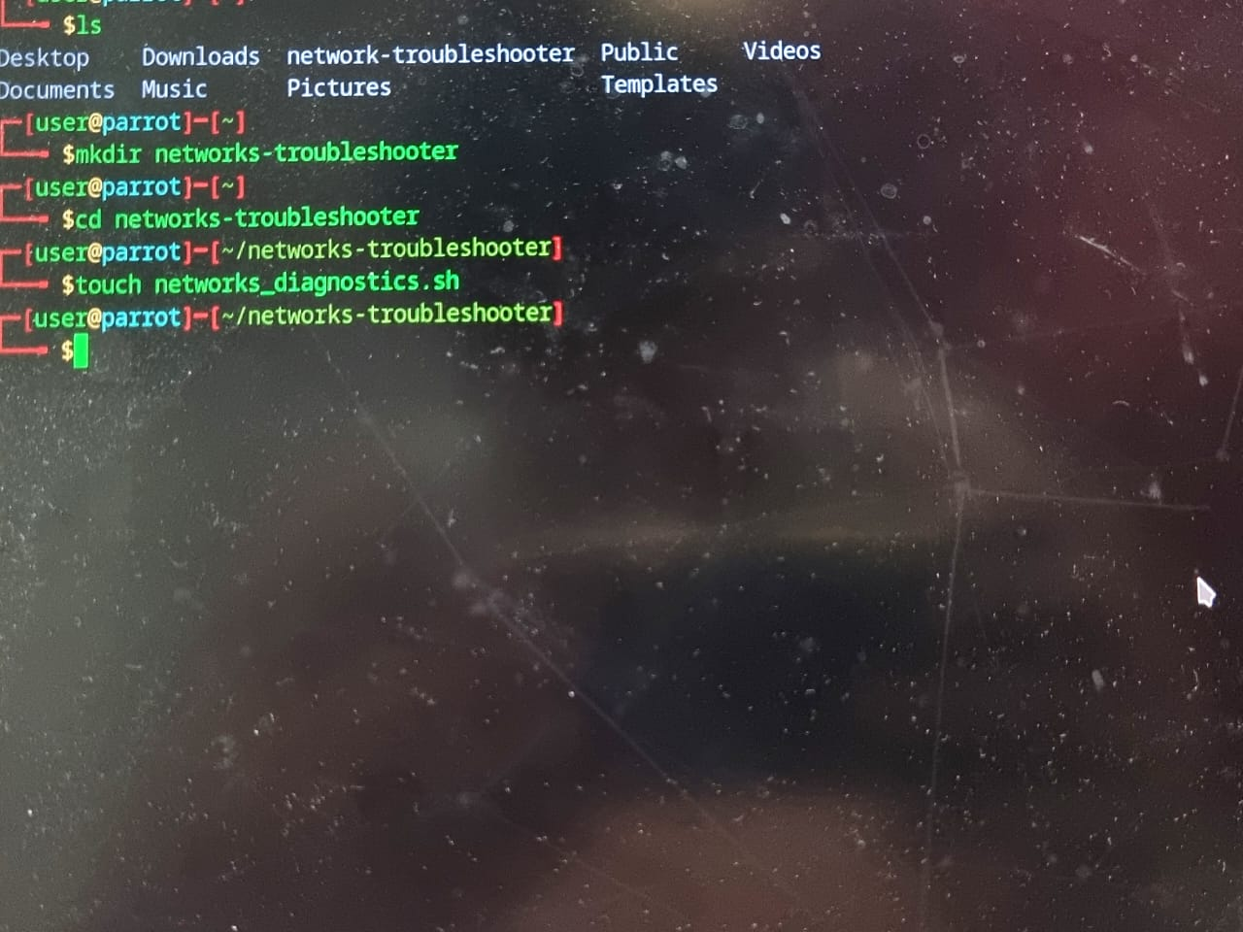
6. Create a shell script file name such as (network_diagnostics sh).

Slide 14
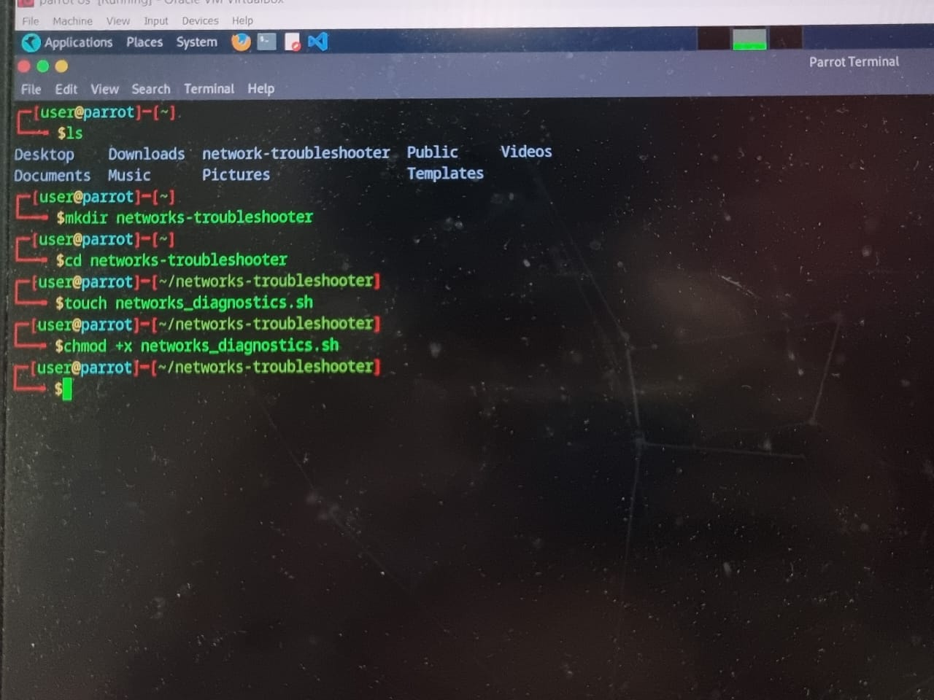
7. Change permission and apply only execute command.

Slide 15
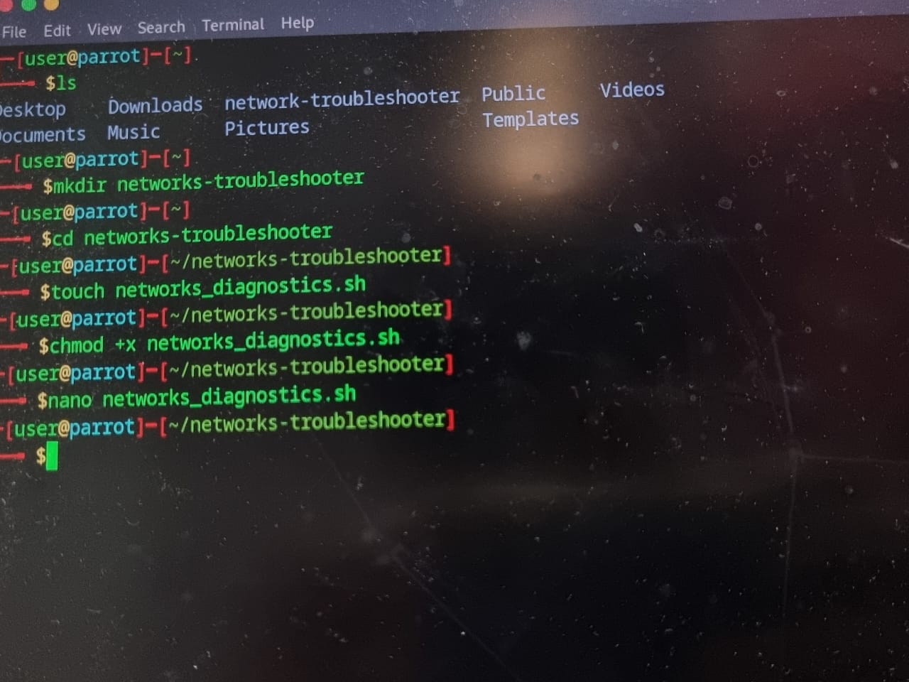
8. Edit shell scripts file apply nano command.

Slide 16
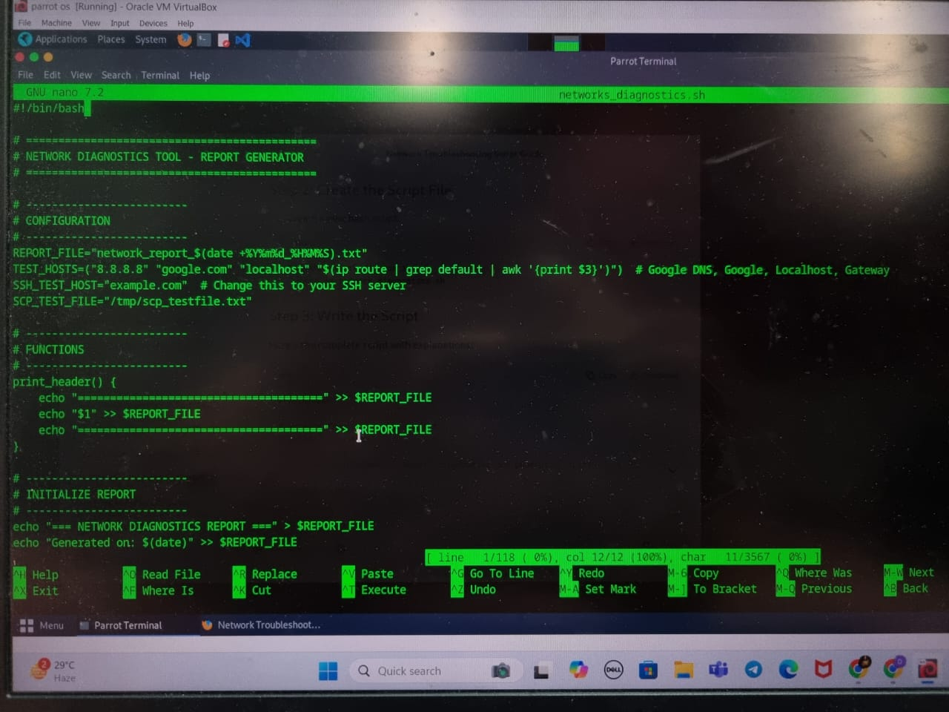
9. Open nano editor and create a bash script file

Slide 17
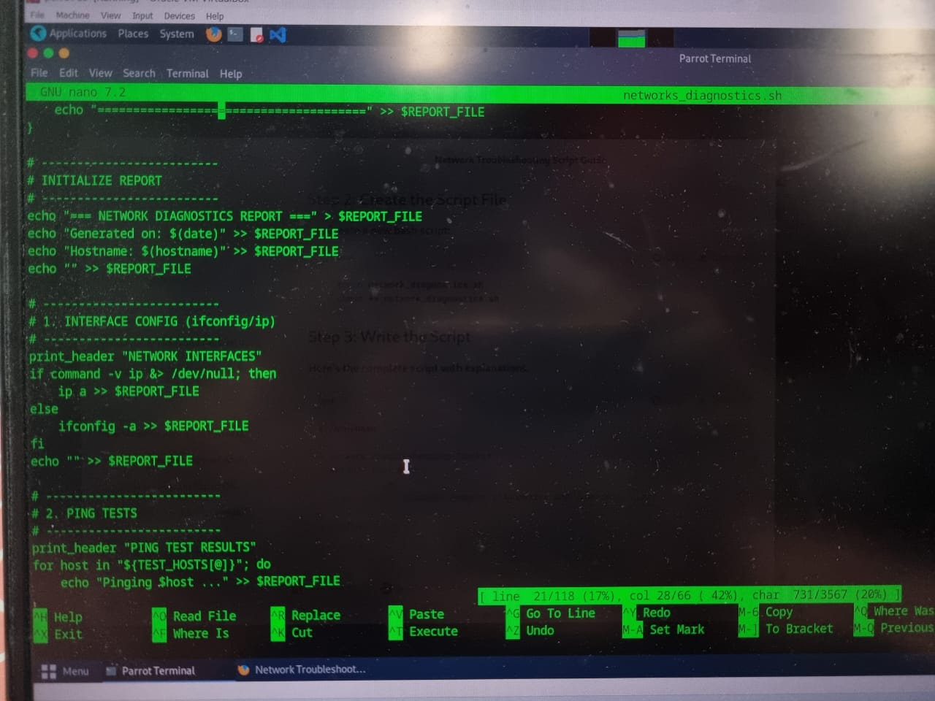
8. Continue…

Slide 18
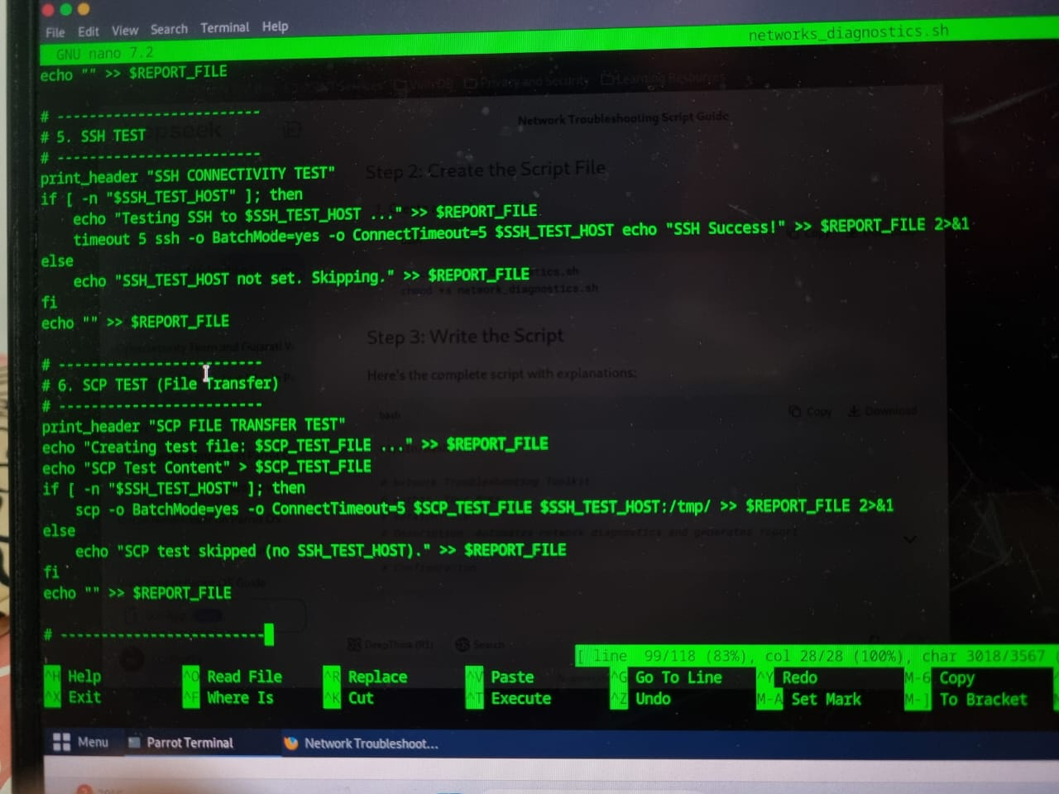
8. Continue ….

Slide 19
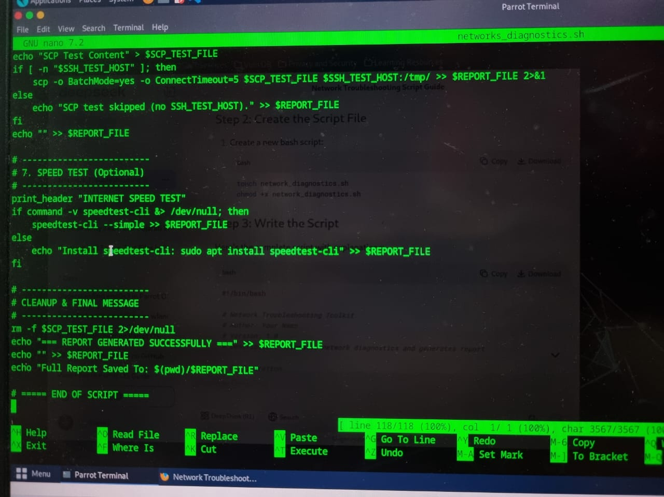
8. Continue… and apply Ctrl + X and save the file, click on Y and exit

Slide 20
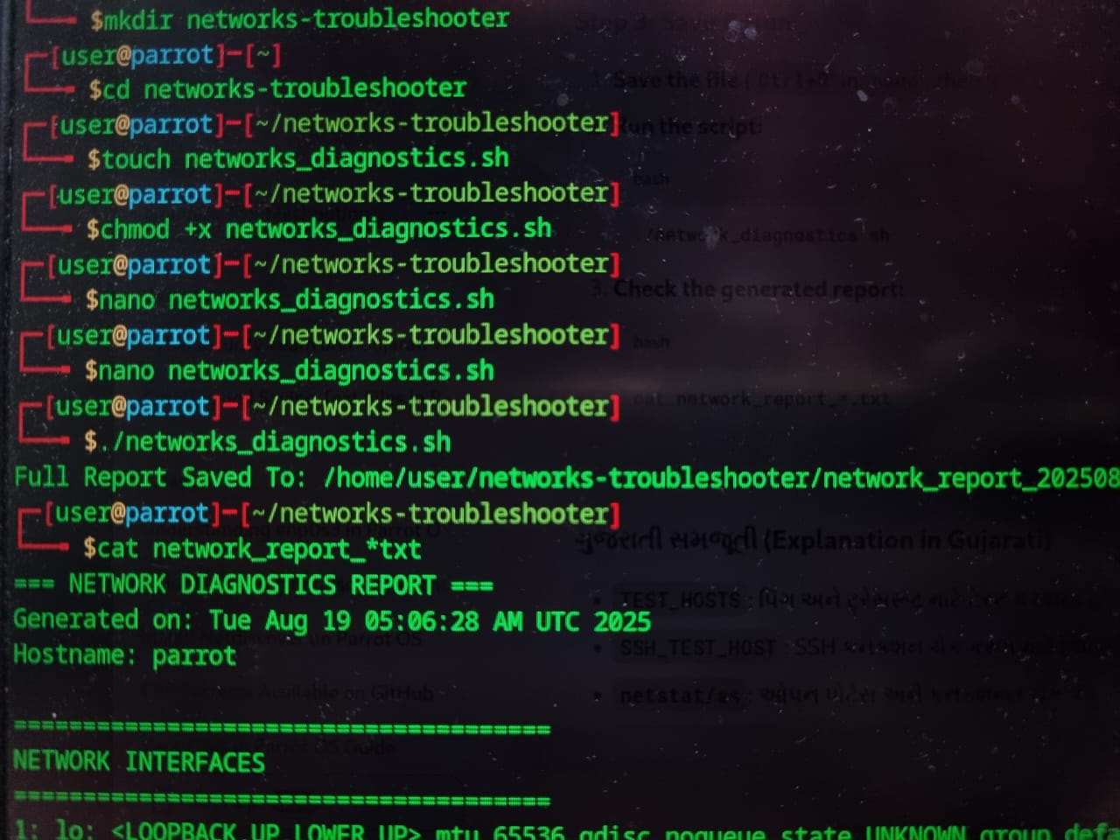
9. Run shell script file(. /network_diagnostics.sh)

Slide 21
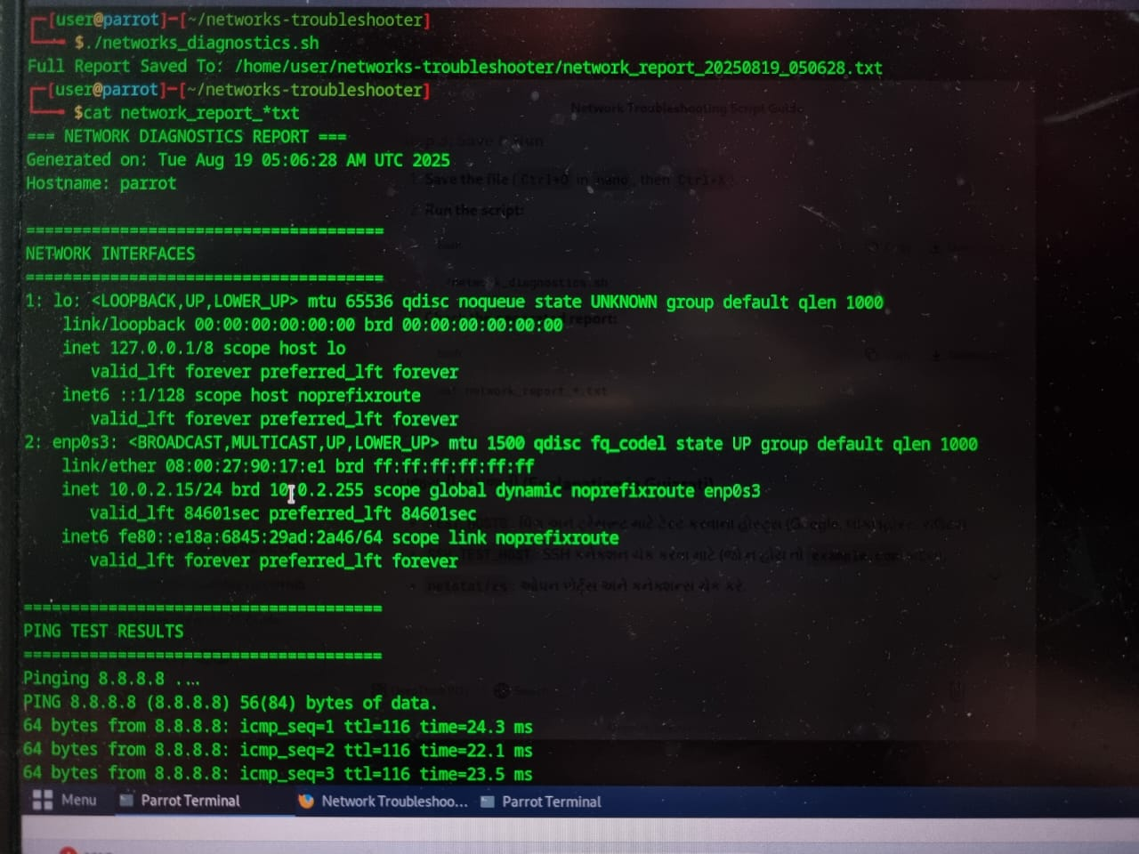
10. And show this shell file, such as (cat network_report_*.txt)

Slide 22
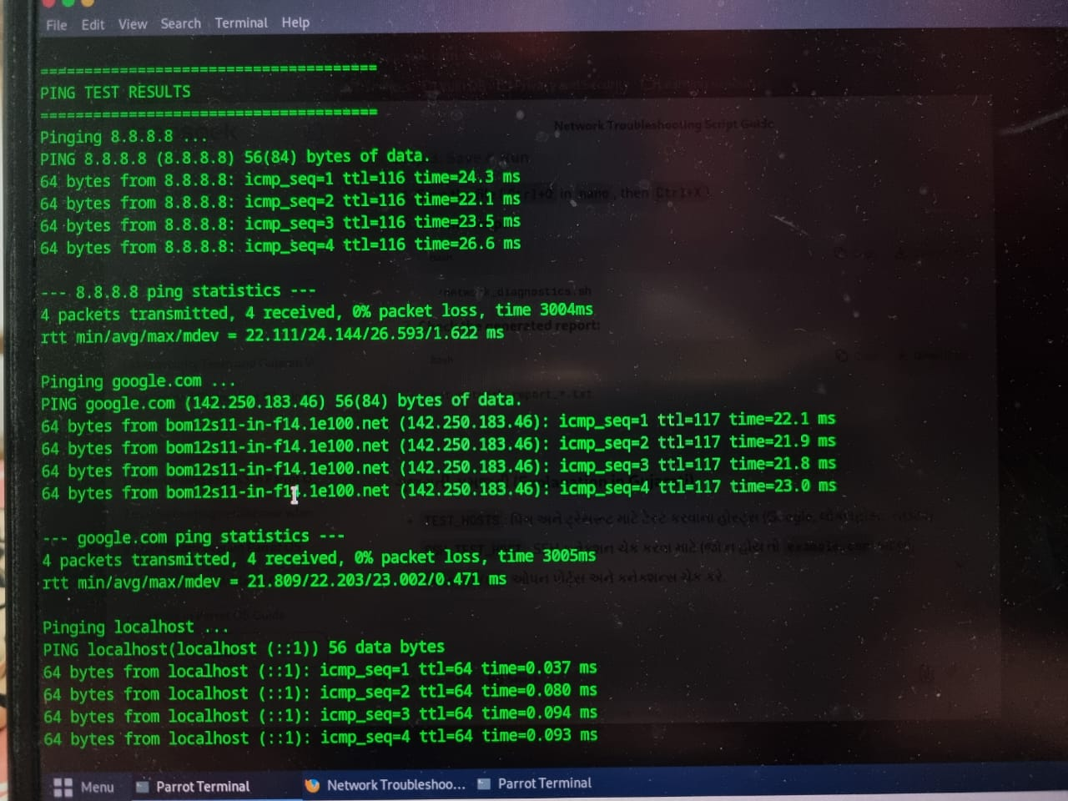
10. continue…

Slide 23
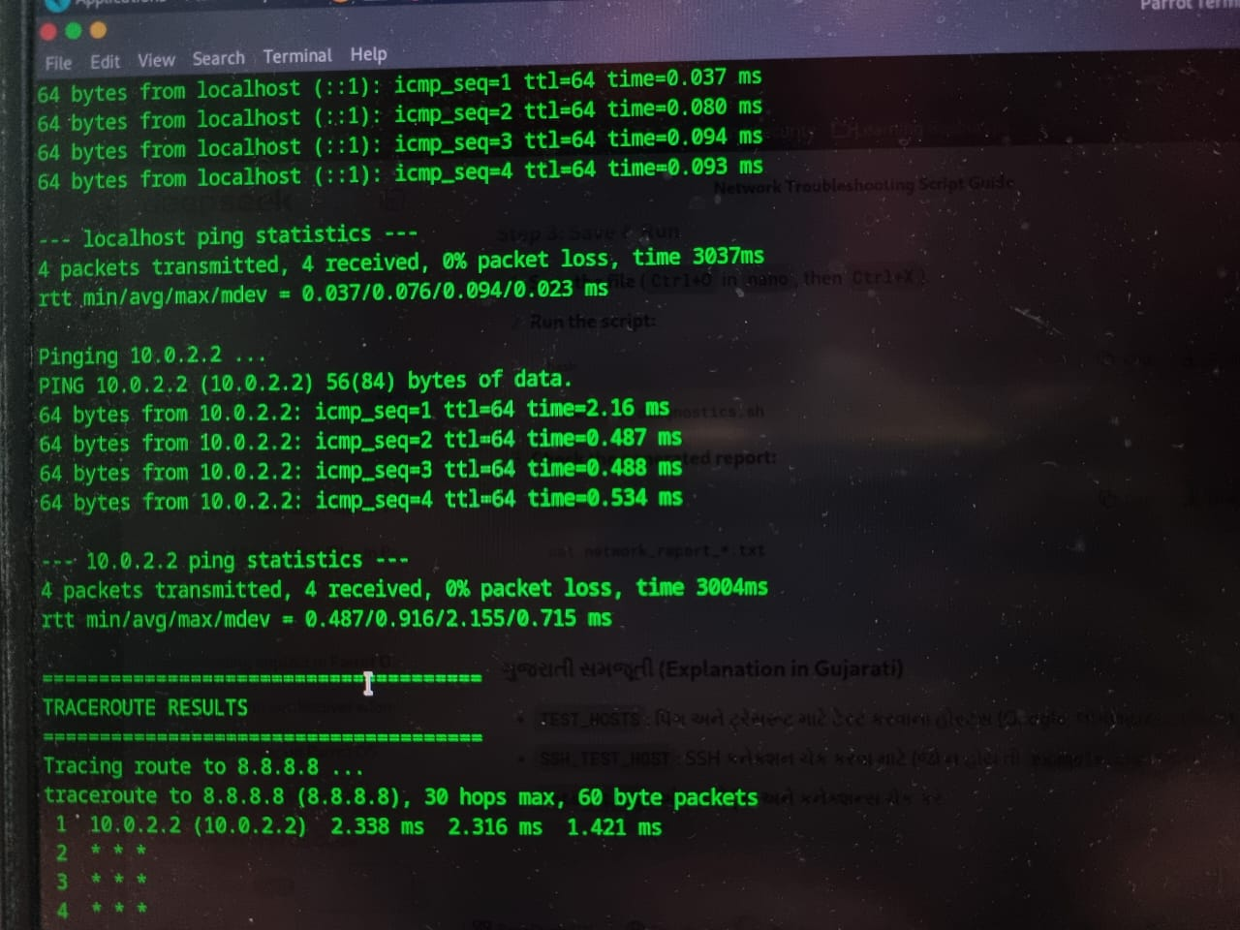
Continue…

Slide 24
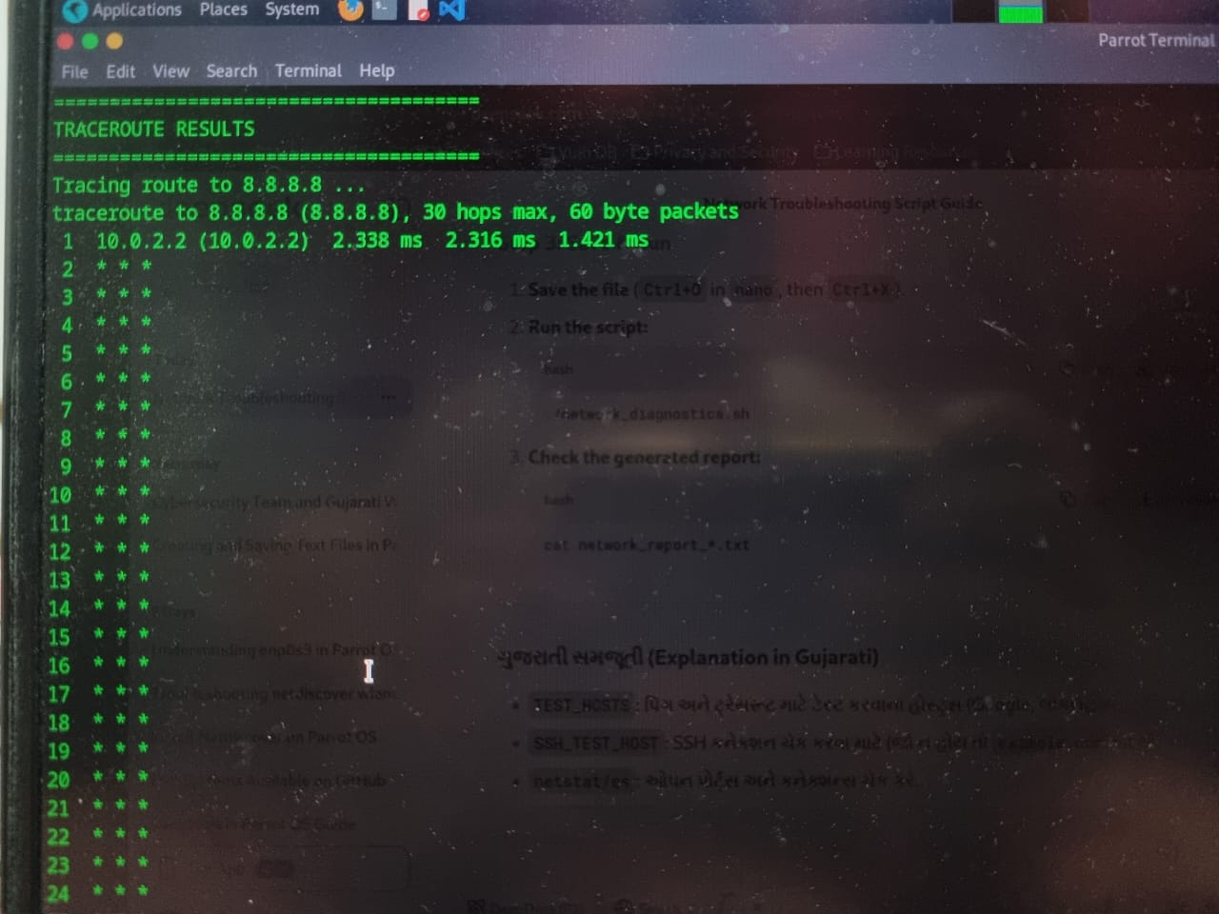
Continue …

Slide 25
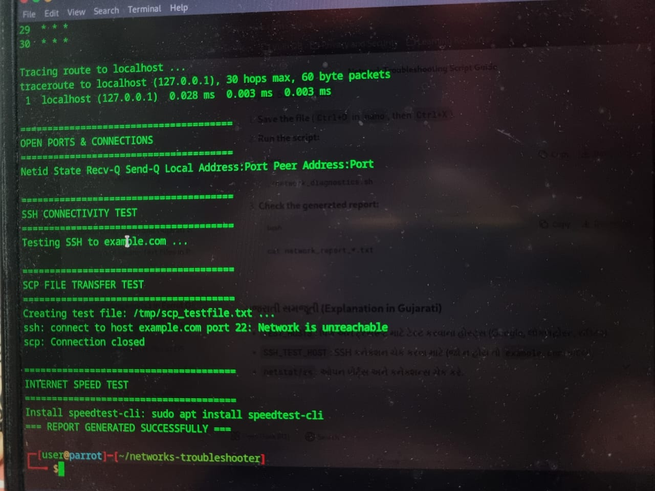
Continue…

Slide 26
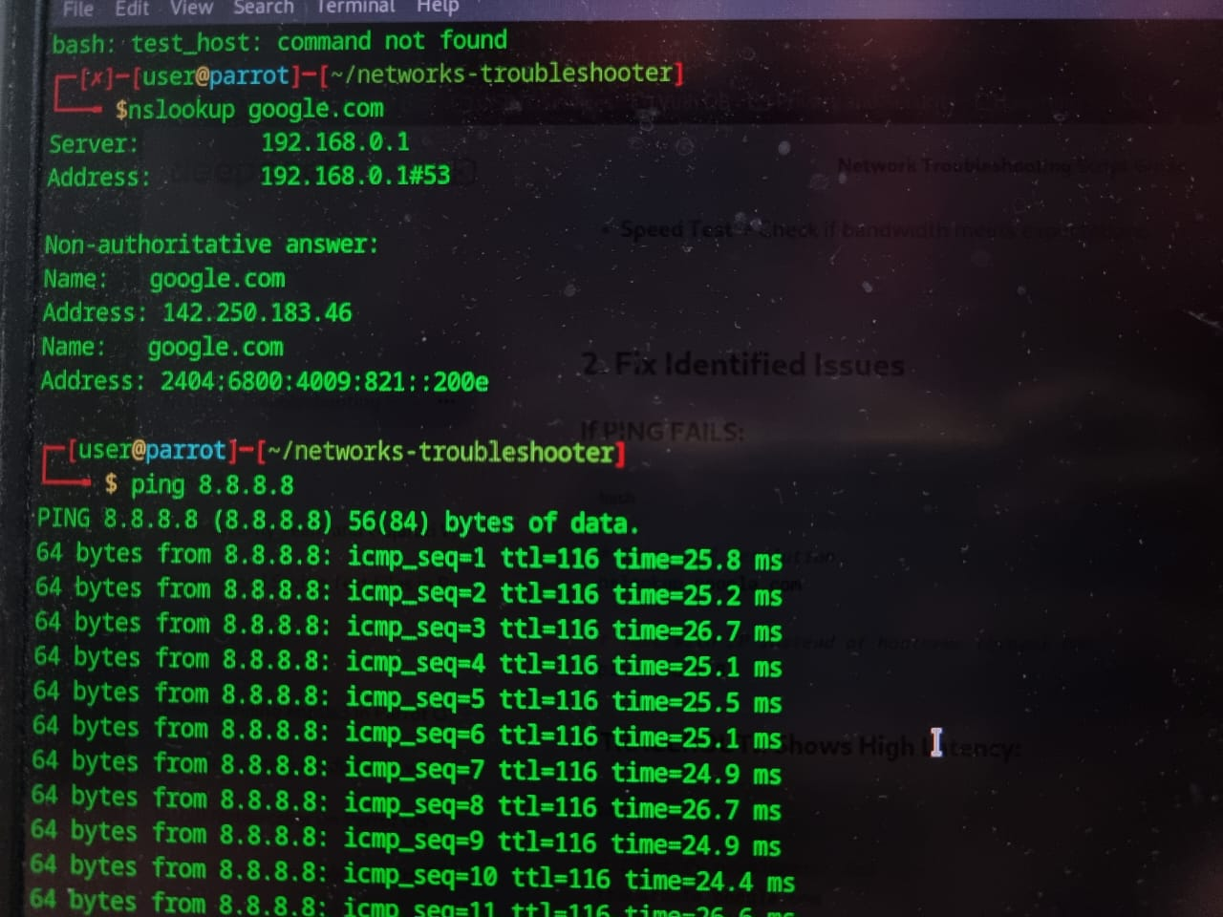
11. Analysis by nslookup and ping command and match in the shell file

Slide 27
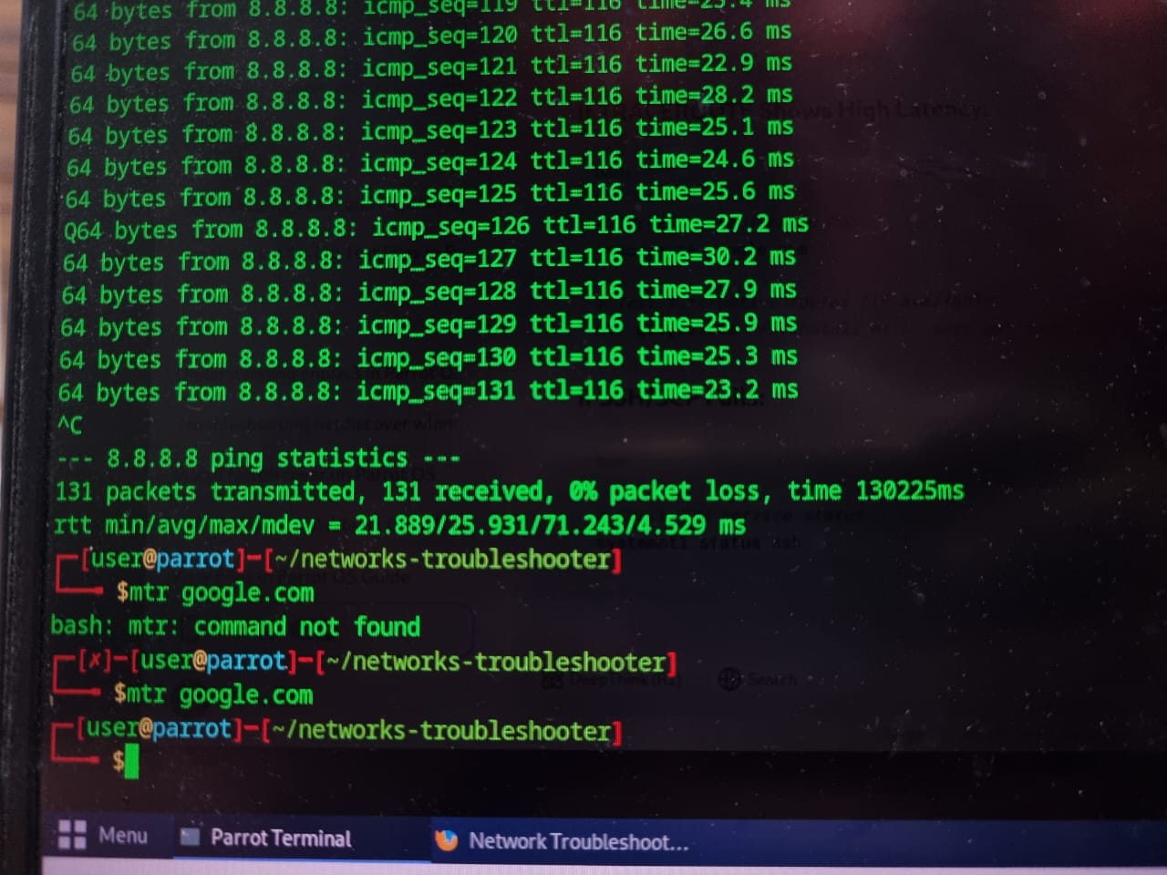
Test the alternative routes(mtr google.com)

Slide 28
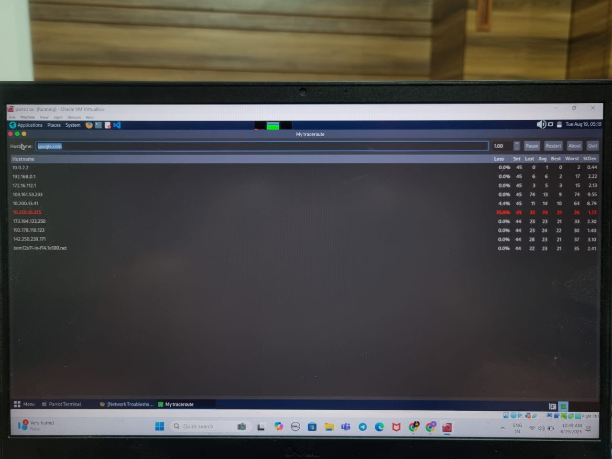
13. And automatically open My-traceroute editor and then quite

Slide 29
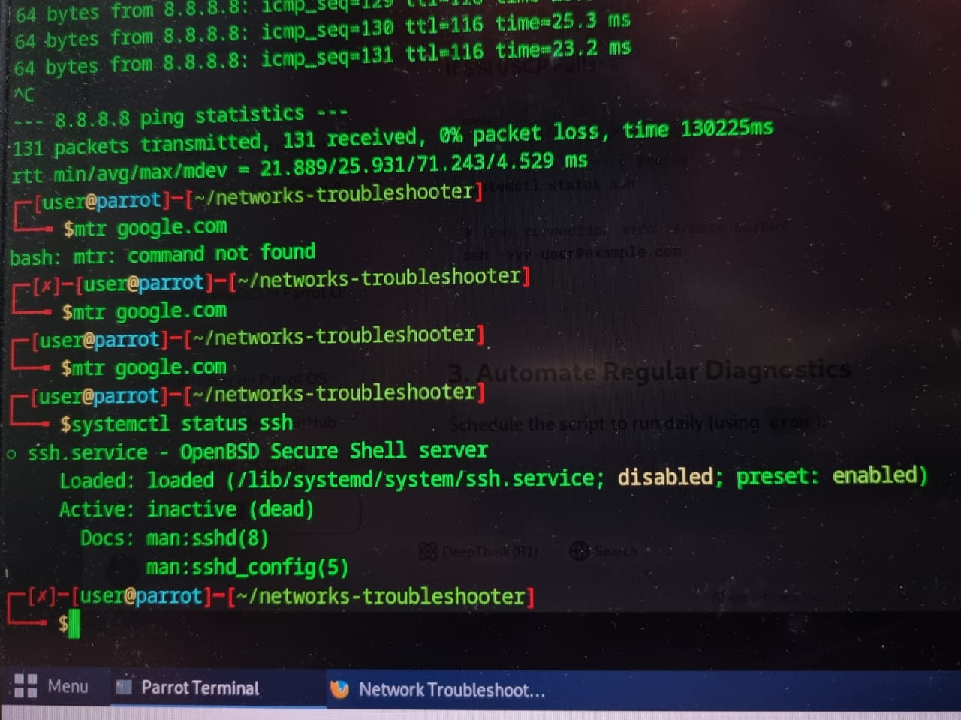
14.Check SSH service status

Slide 30
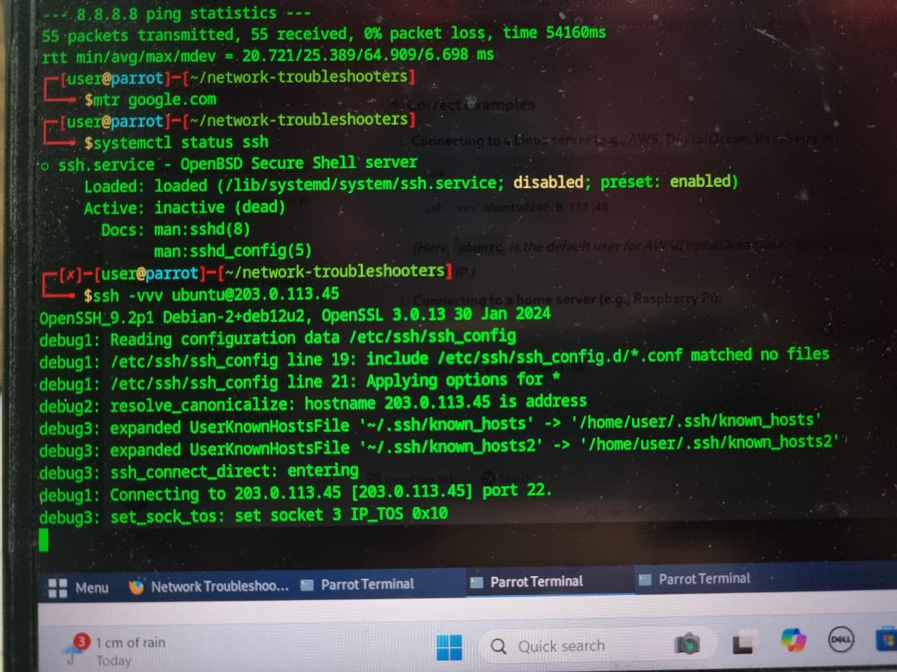
15. Test connection with verbose output

Slide 31
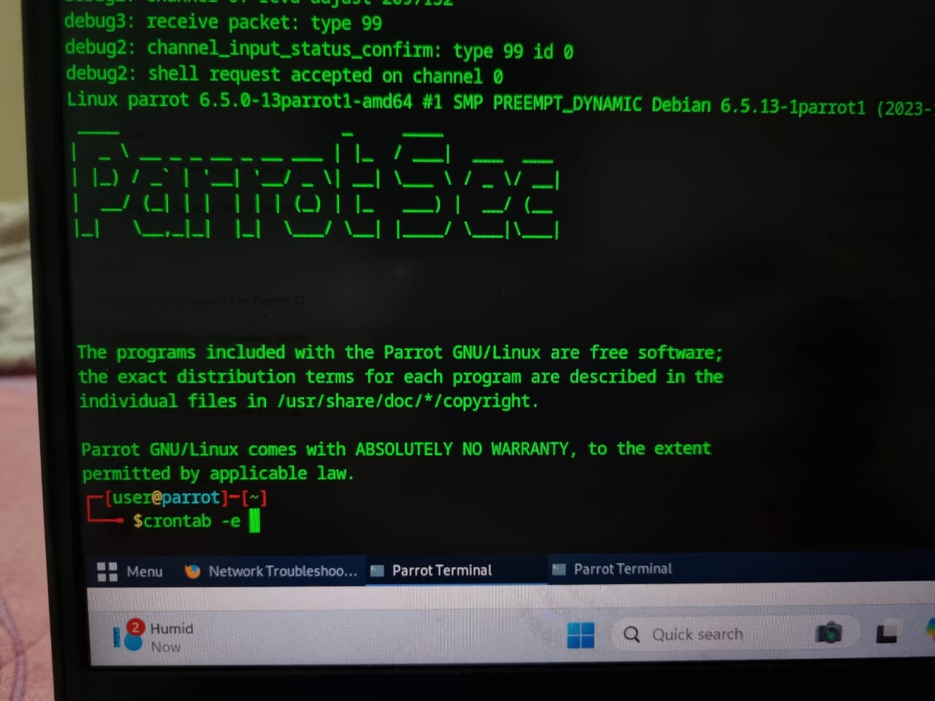
16. Open crontab editor(crontab –e)

Slide 32
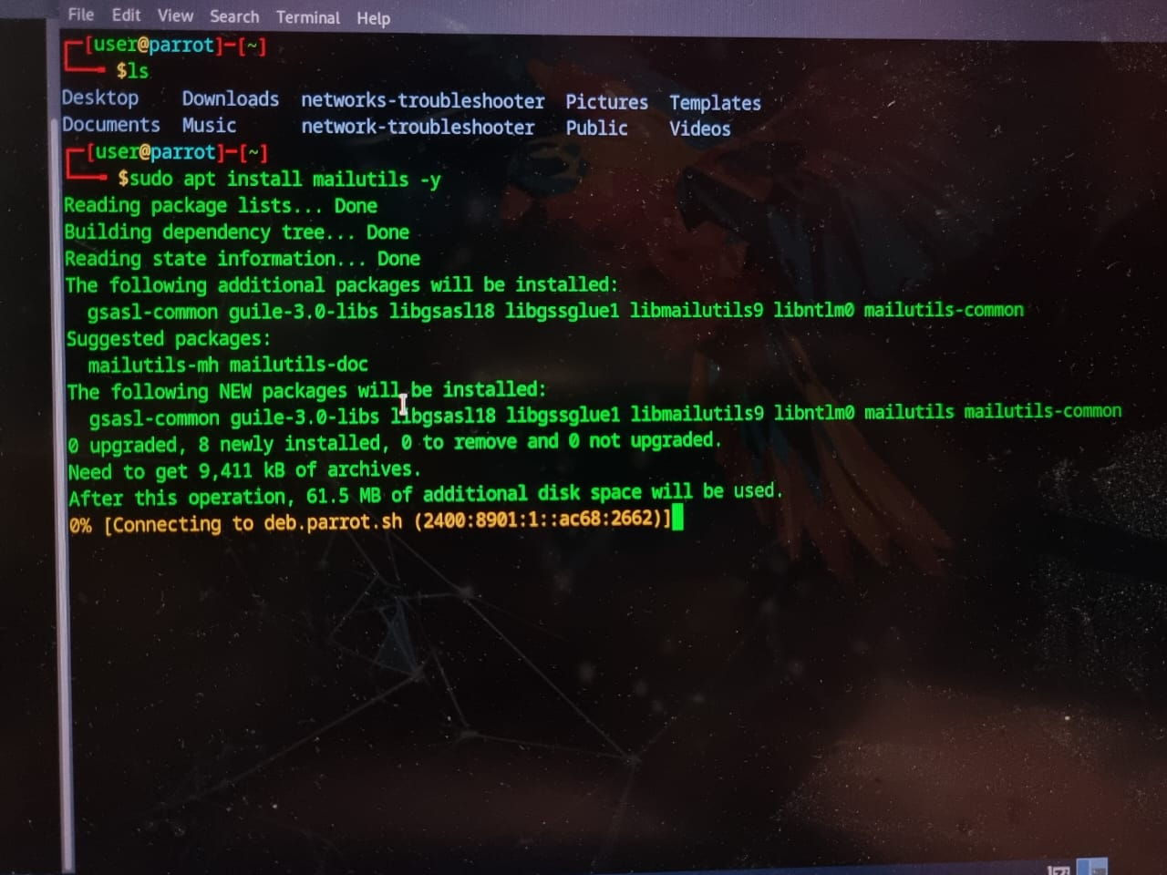
17. Install mailutils(sudo apt install mailutils)

Slide 33
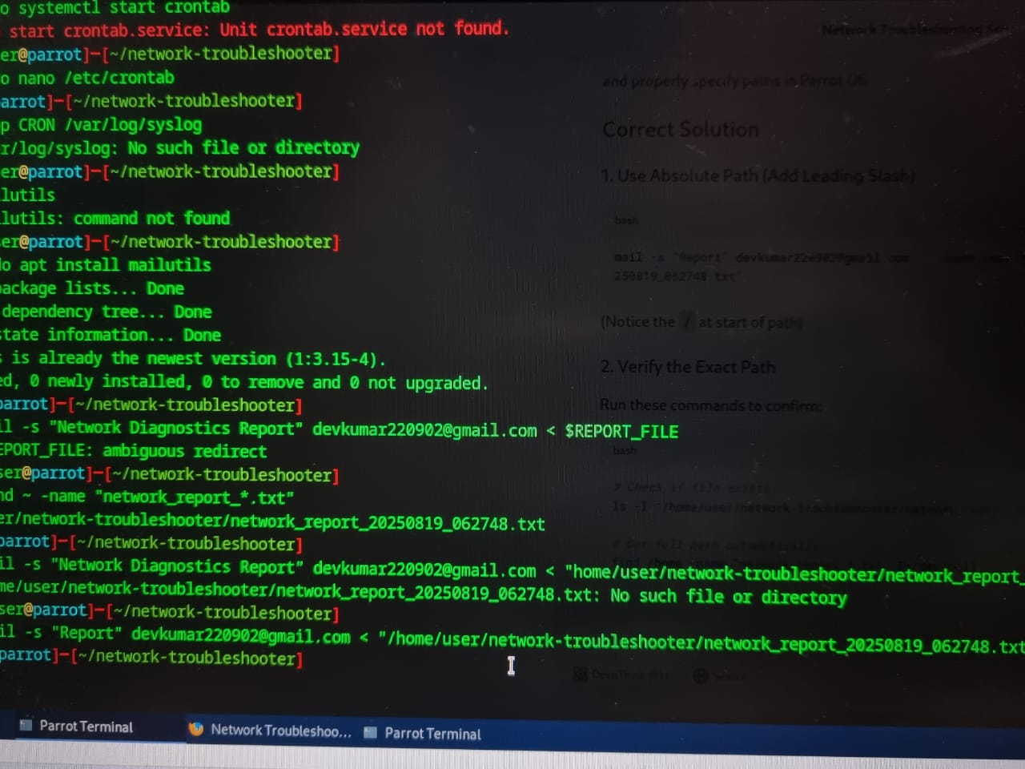
18. Find path for network_report

Slide 34
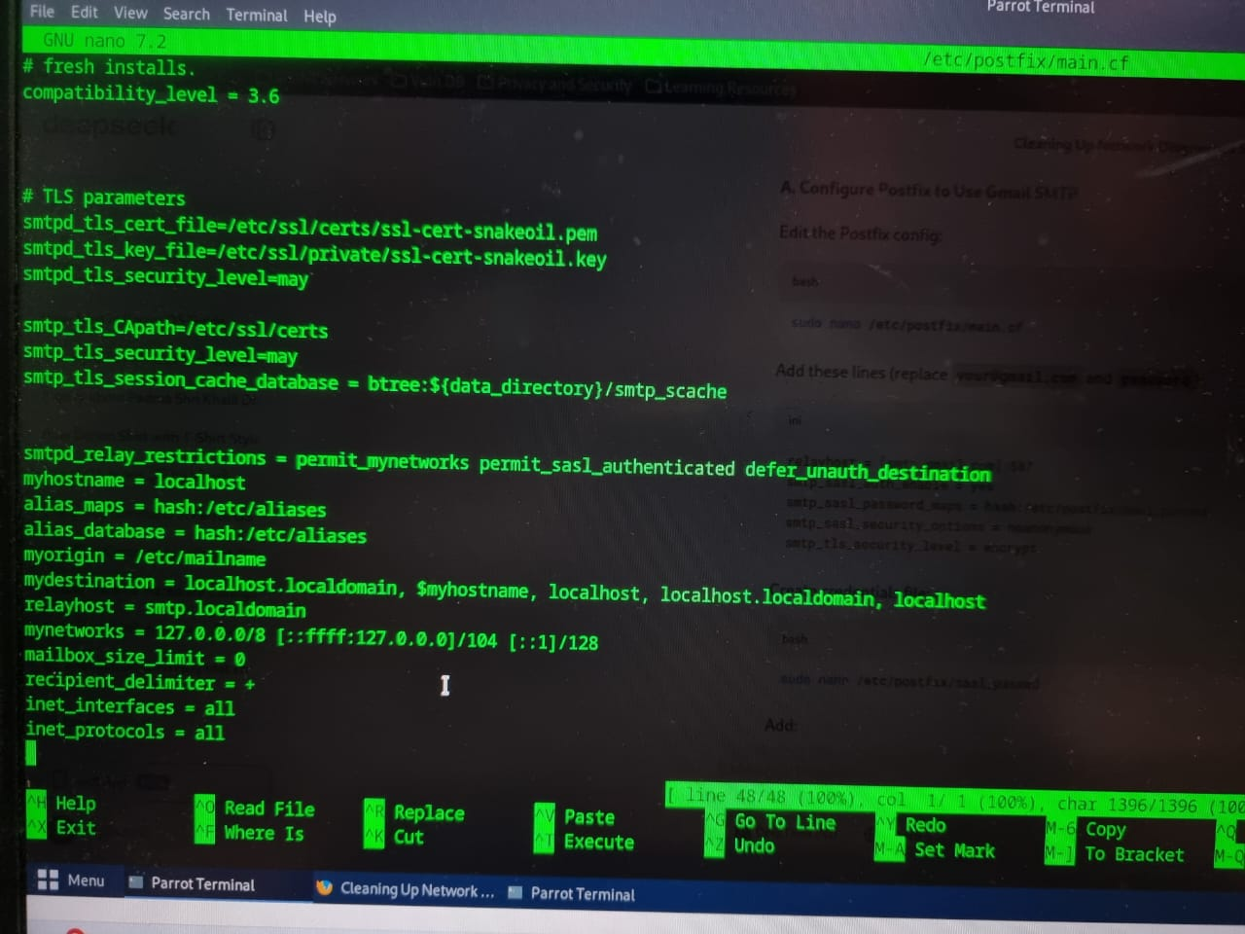
19. Open nano editor and add email/external SMTP and exit

Slide 35
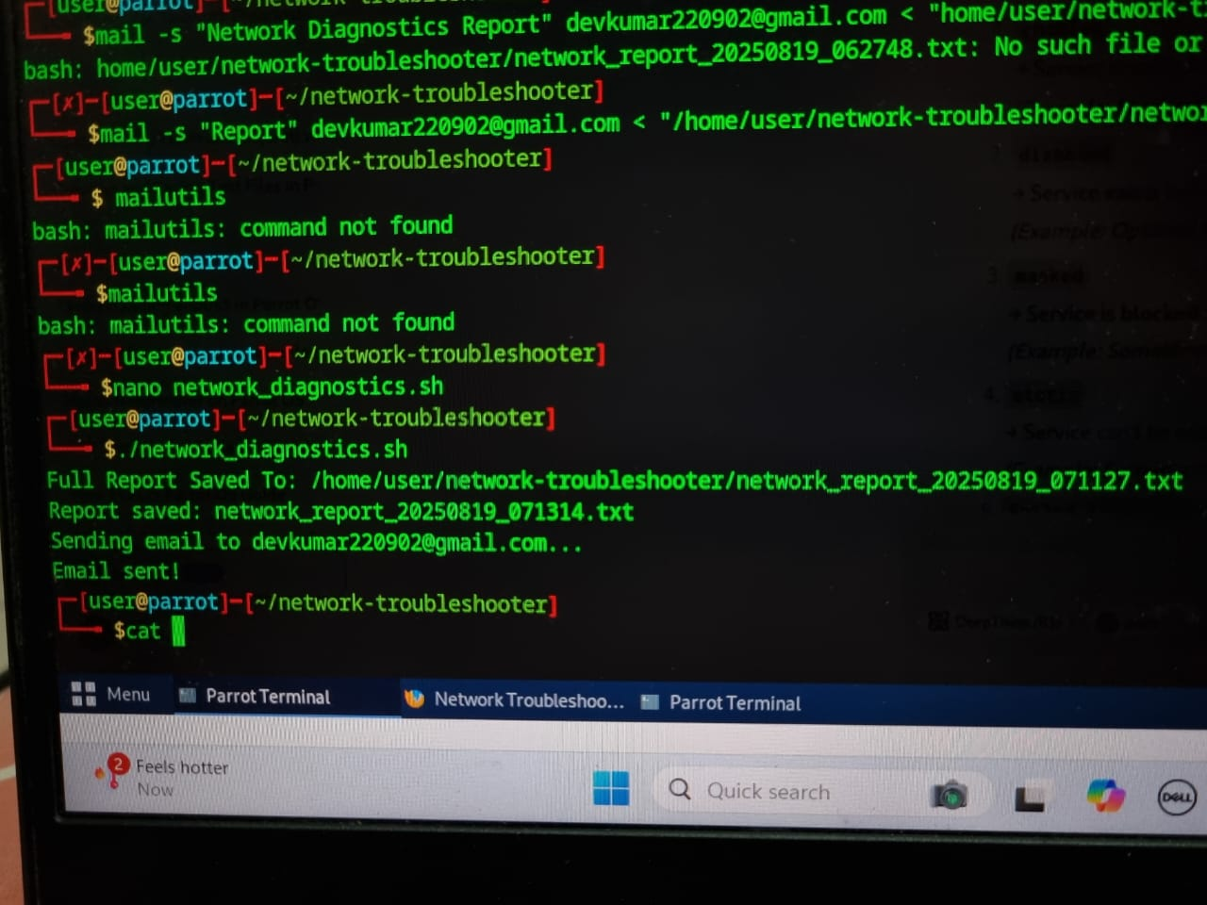
20. And run email/external SMTP shell script with full path

Slide 36
21. And then successfully email sent

Slide 37
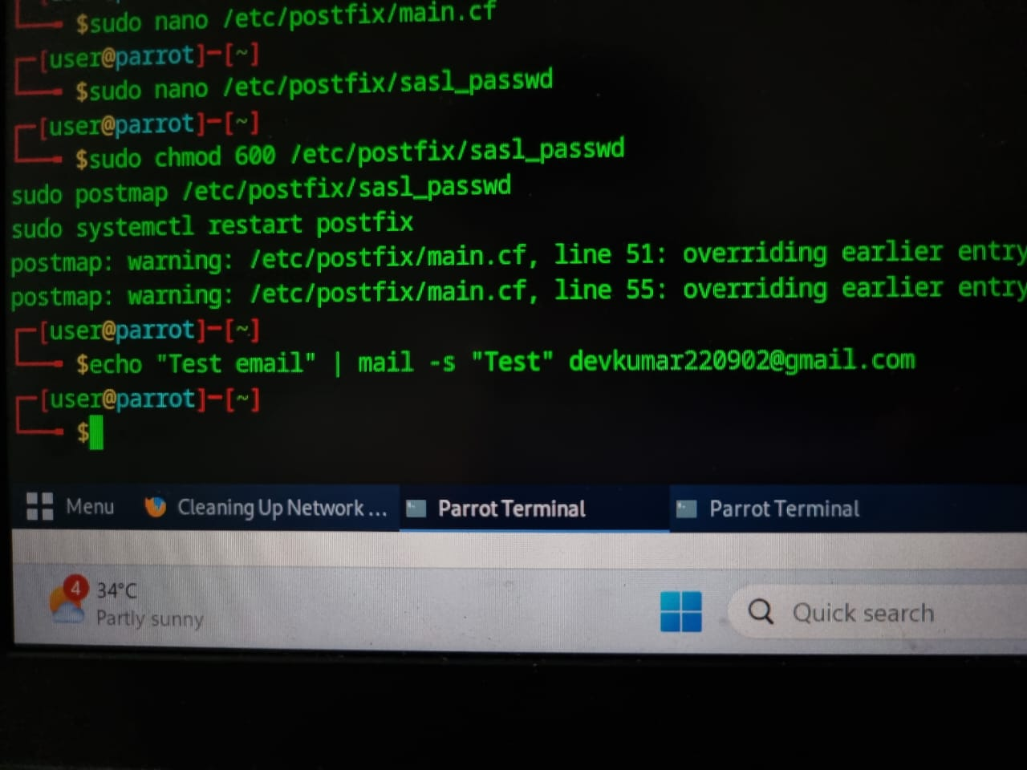
22. And then print final exetrenal gmial command

Slide 38
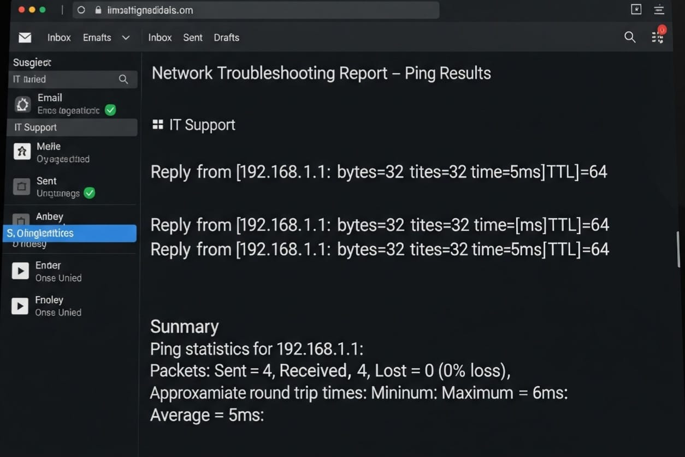
23. And finally, I successfully got Gmail through the network report

Slide 39
6. Conclusion
The Network Diagnostics Automation Project successfully transformed a fragmented and manual troubleshooting process into a streamlined, efficient, and reliable automated workflow. By developing a comprehensive Bash script, we achieved the core objective of standardizing initial network health assessments, ensuring consistent and thorough diagnostics regardless of operator experience.

Slide 40
Thank You…

